Slide 1
Keeping Your Team Together During Uncertain Times
Presenter: Kevin Howard,
Director of Housing & Neighborhood Programs
City of Little Rock

Slide 2
How Do We Keep Our Team Focused, Motivated, & Resilient When The Ground Beneath Us Is Shifting?
Use the Four C’s
1. Clarity – Be transparent about what’s known and unknown
2. Consistency – Create regular touchpoints to reduce rumors
3. Compassion – Make room for emotion without losing direction
4. Commitment to Mission – Reinforce why we do what we do!
The Washington Report is a good way to provide information to your staff about funding updates. This report comes from Vicki Watson each month and sometimes weekly if you are a member of NCDA.

Slide 3
Strategies to Keep Teams Together
Have Open & Honest Communication Often
Weekly updates (even if nothing has changed)
Allow questions, and be honest if you don’t know
Empower & Involve
Involve staff in solution-finding
Form working groups for resource optimization
Celebrate Small Wins
Highlight progress – even minor – toward housing, public services, homeless services, etc.

Slide 4
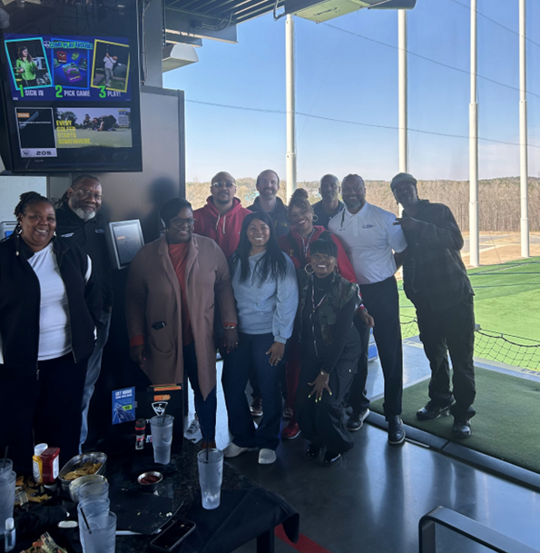
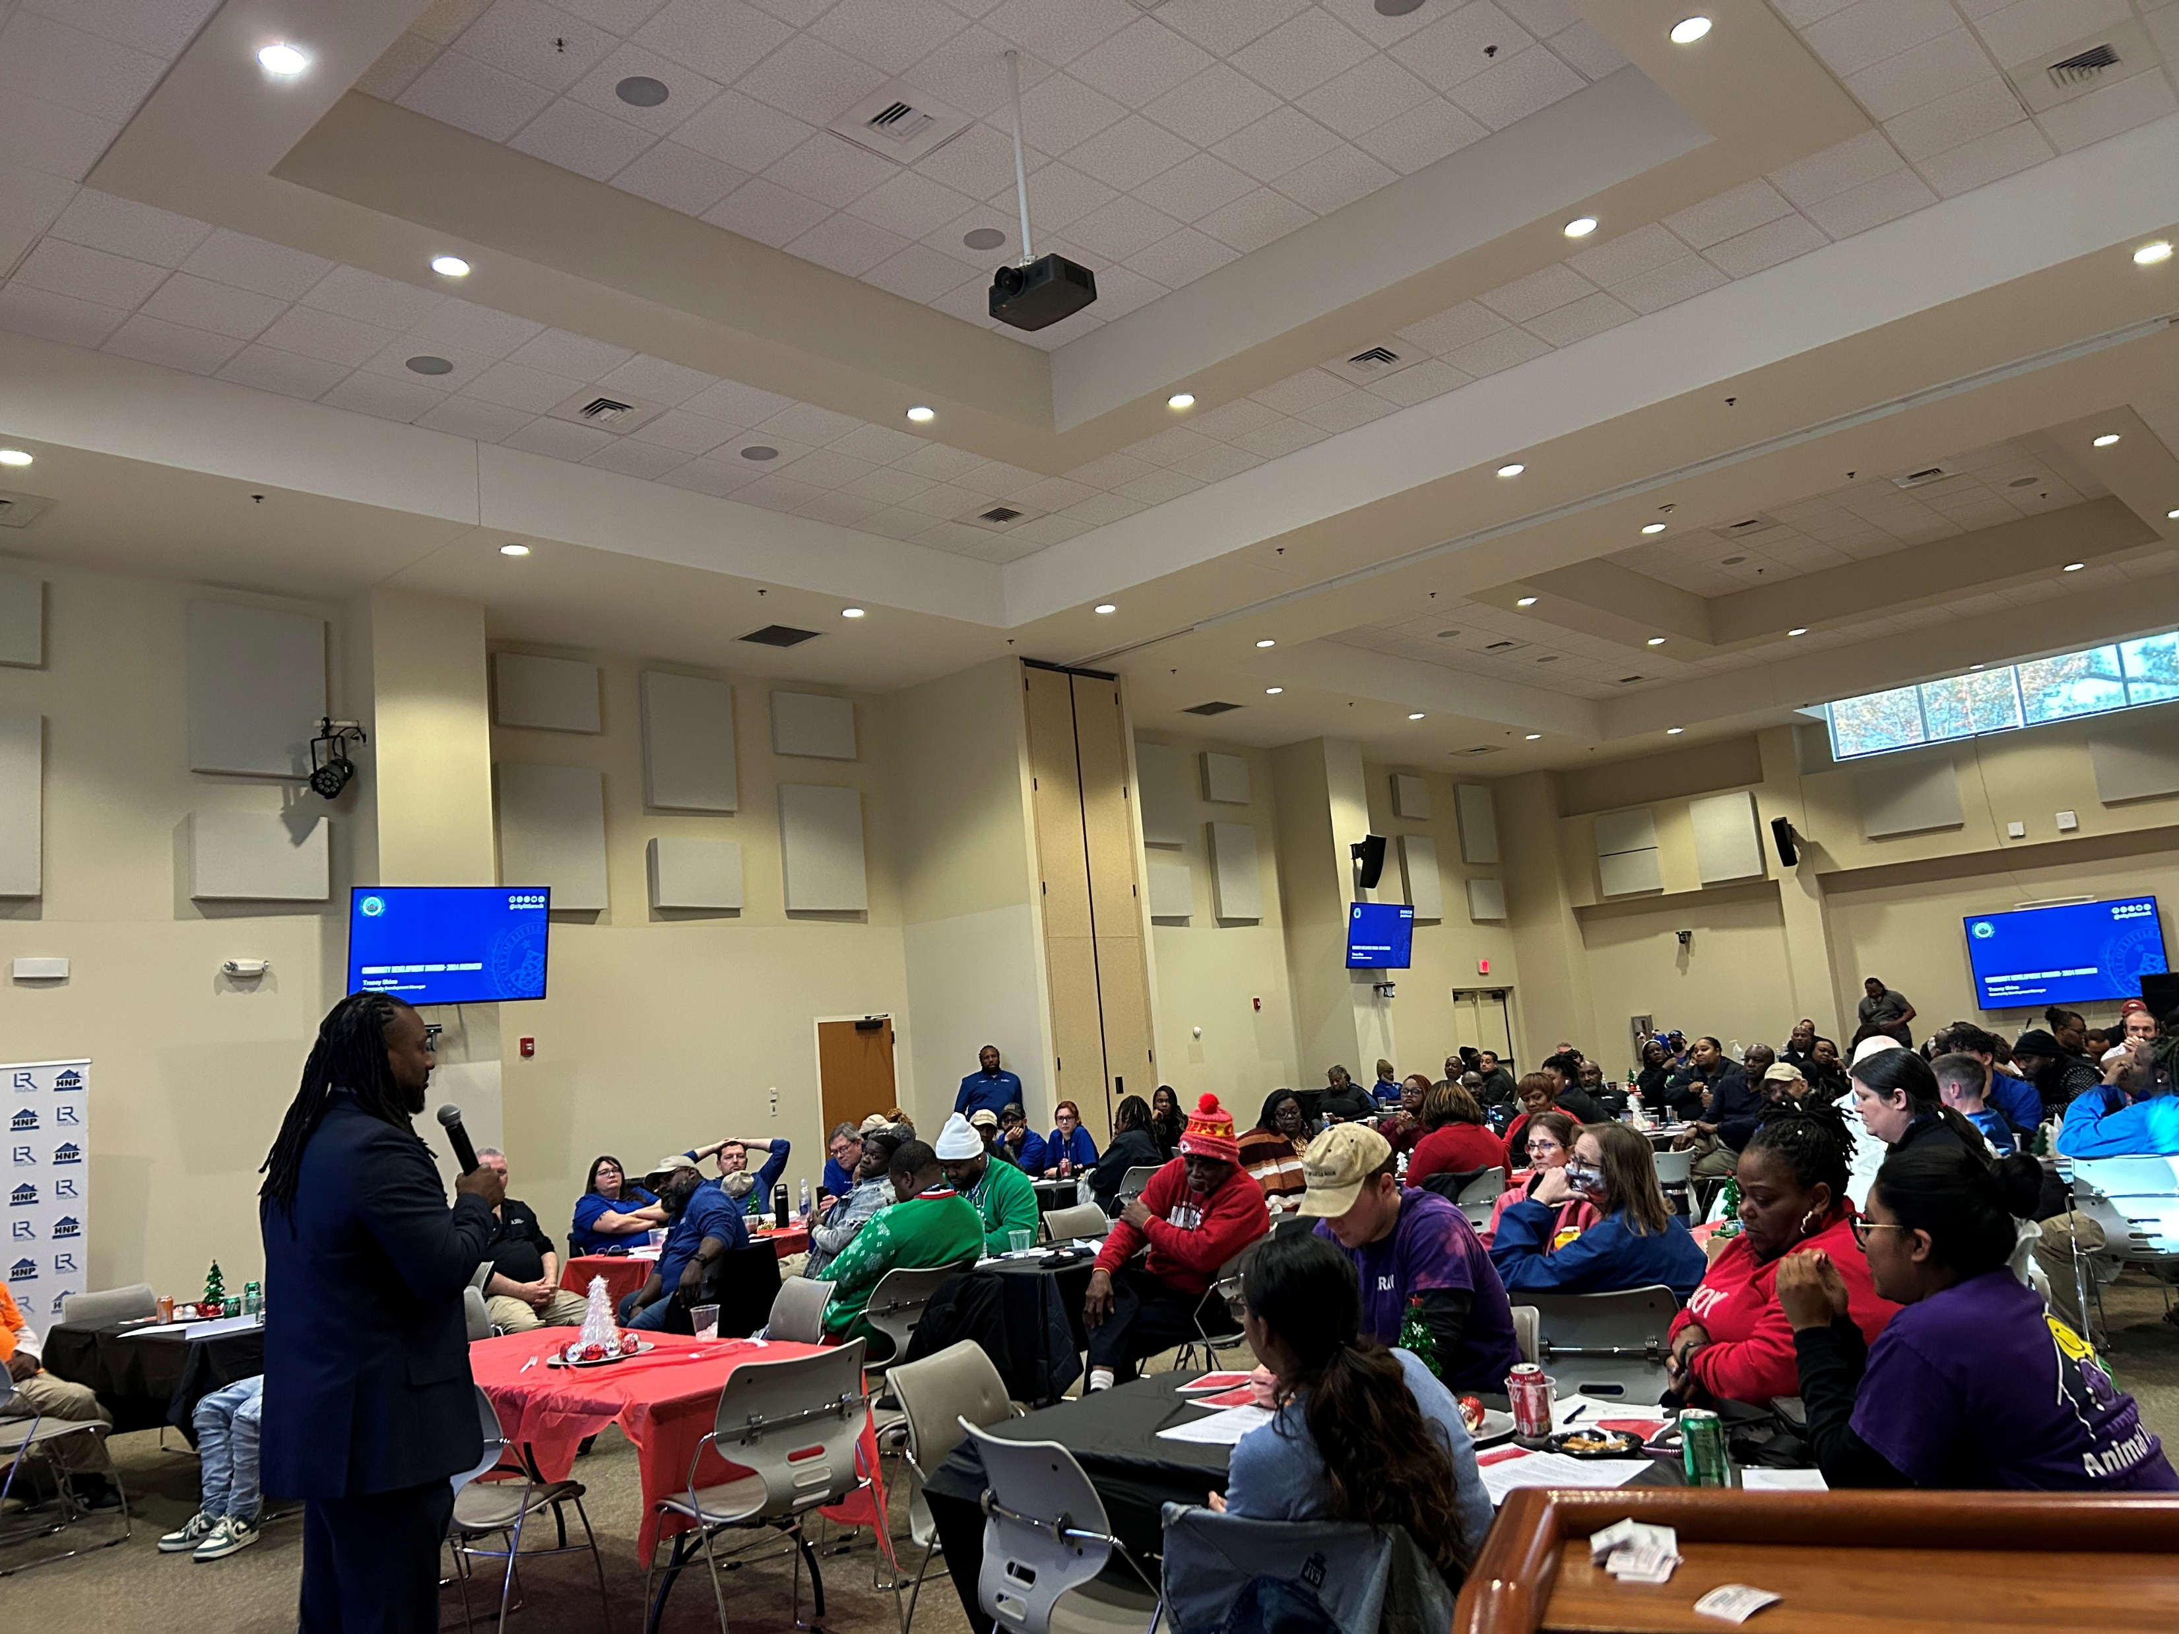
Key Strategies for Motivation
Professional Development
Recognition & Appreciation (Shout-outs, extra time off)
Supportive Leadership

Slide 5
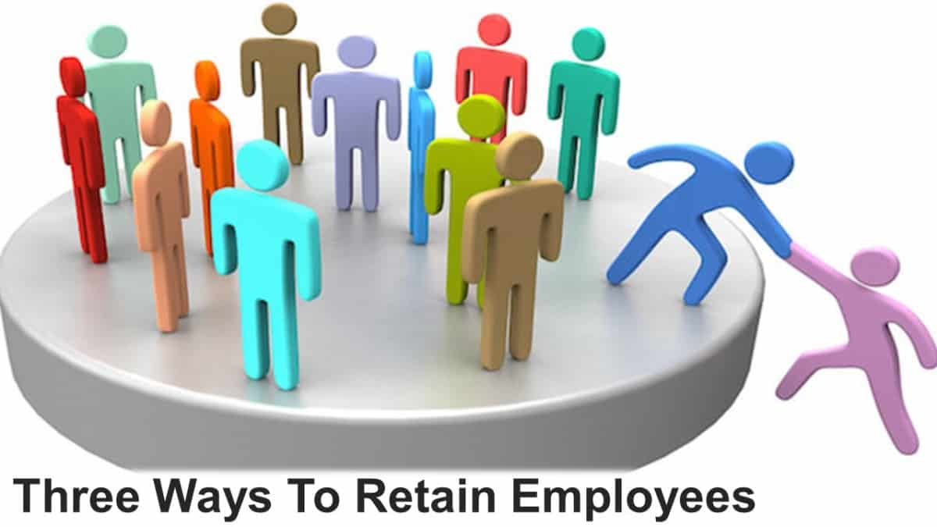
Why Motivation is Important
Retaining employees is crucial
Motivated staff tend to be more innovative (important during this time)
Maintain productivity

Slide 6
Key Strategies for Motivation
Highlight Impact Stories
Involvement in Grant Renewal Efforts

Slide 7
Call to Action
Recognition, Appreciation, Growth
Honest Communication
End team huddles, meetings with inspirational quotes

Slide 8
Call to Action
4 KPI’s
Keeping People Informed
Keeping People Involved
Keeping People Interested
Keeping People Inspired
During these uncertain times in the Community Development world, leaders and managers need to inspire their teams, bring people together, boost morale and learn what works and does not work to improve your areas to keep staff grounded.

Slide 9
Community development team
Questions?

Slide 10
Community development team
Thank you
Kevin Howard| Director
@citylittlerock

